Slide 1
Project 1
DS804

Slide 2
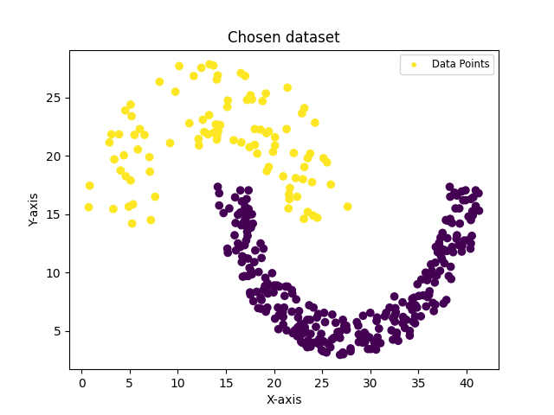
Choice of Dataset

Slide 3
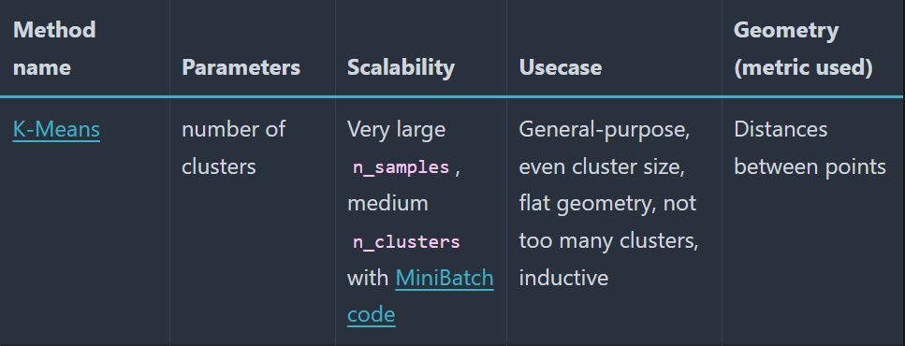
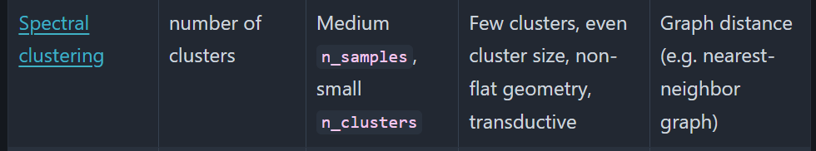
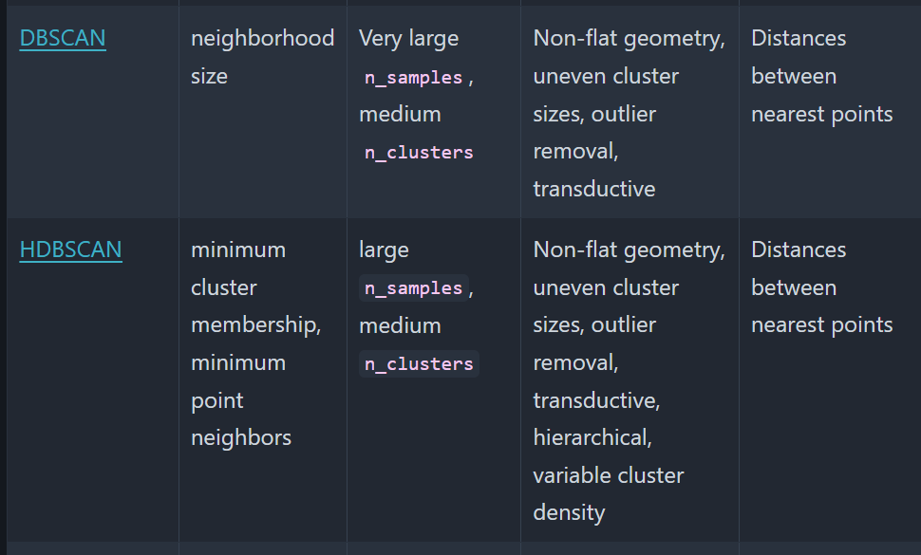
Which algorithms were used?
2d dataset makes choice quite simple
Non convex shape suggests, that distance based metrics give scewed results
Suggests that a proximity based algorithm should be used
Parameters to choose from:
Known cluster count (k=2)
Small sample size (n < 1000)
No noise
Non flat geometry -> shapes are ”overlapping” even though they follow well defined clusters
Ideal algorithms:
Spectral clustering
Dbscan/Hdbscan

Slide 4
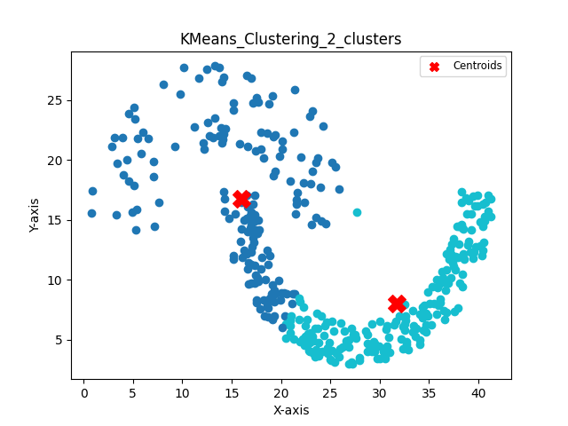
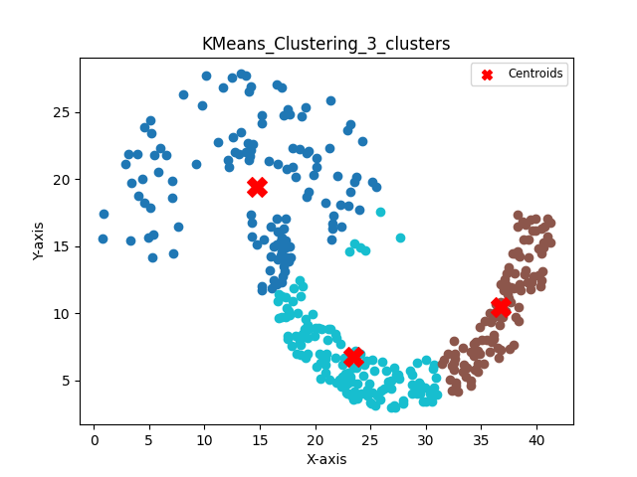
Cluster results
Example of what happens, when choosing kmeans as algorithm.
Dataset uses centroid to determine cluster
Centroid lies within the second cluster

Slide 5
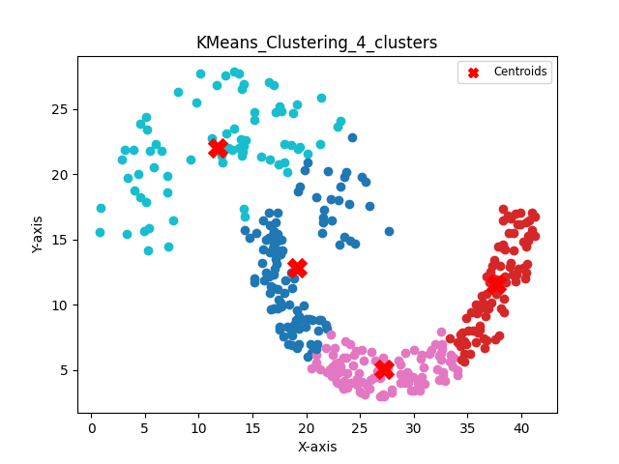
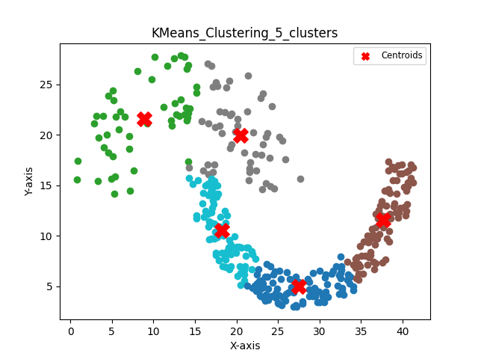
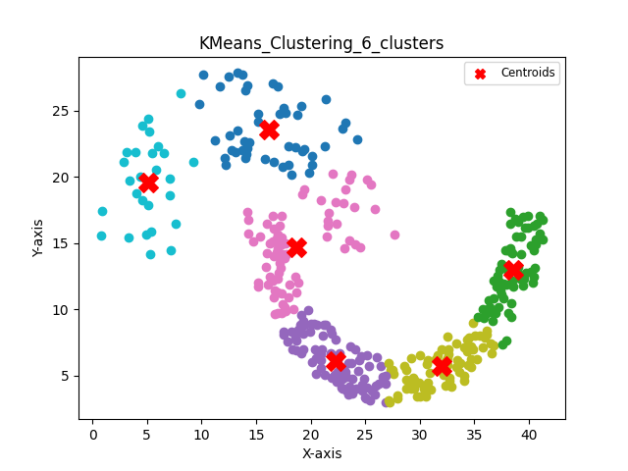
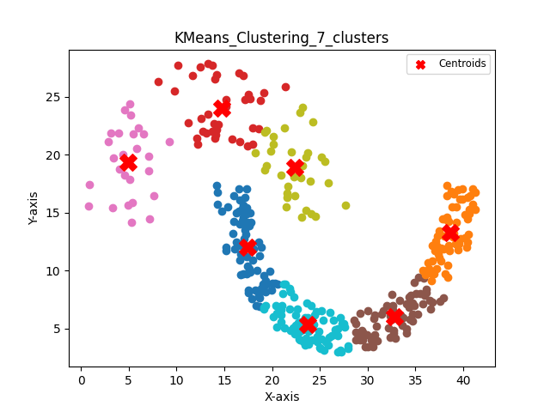
More examples

Slide 6
Dbscan
Nonparametric approach is ideal for non flat geometry
Dbscan:
Assigning clusters based on neighbouring points
Parameters to consider (epsilon)
Epsilon values larger than the gap between the two shapes, will cause them to merge and give suboptimal results.
Minpoints for a point to be considered a core point
Best practices:
Minpoints = 2* dimension
Epsilon estimation -> elbow method (a biased measure). Other methods mentioned later.
For this example it must be exactly small enough to not “leak” into the second cluster.
Drawbacks:
The amount of clusters is already known. Allowing for a non fixed amount of clusters can give bad results?
Doesn’t work well for different density cluster

Slide 7
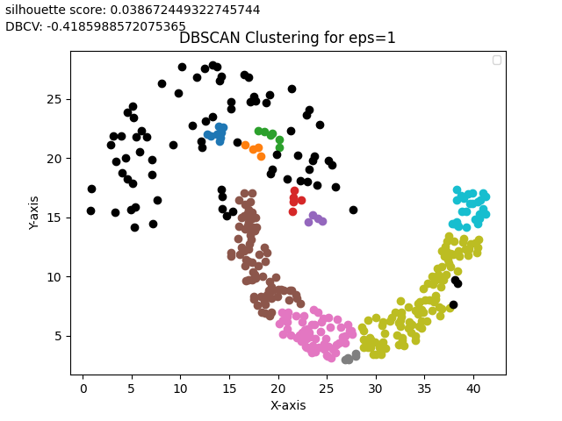
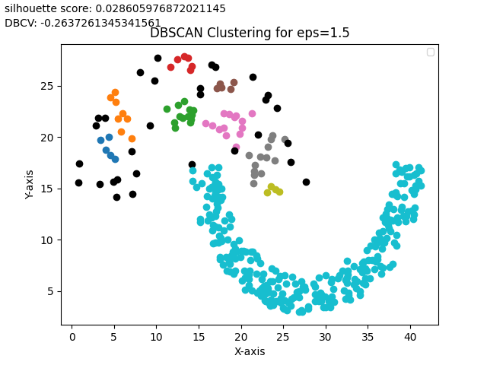
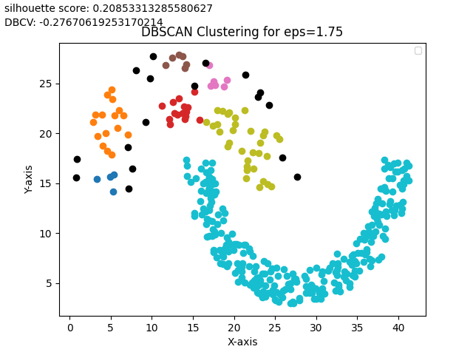
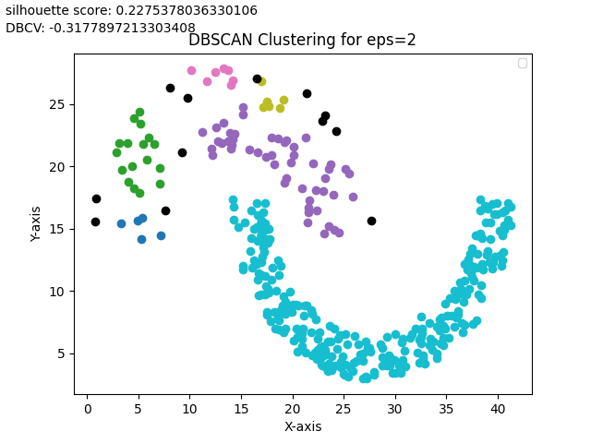
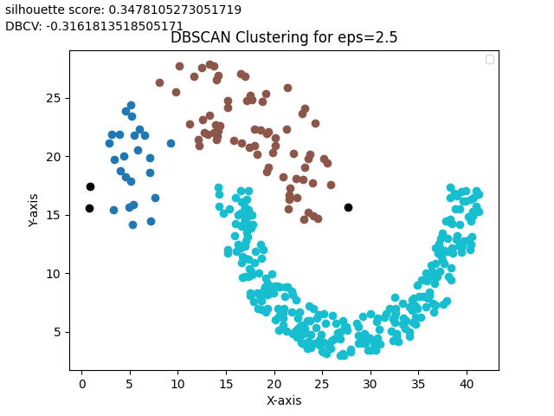
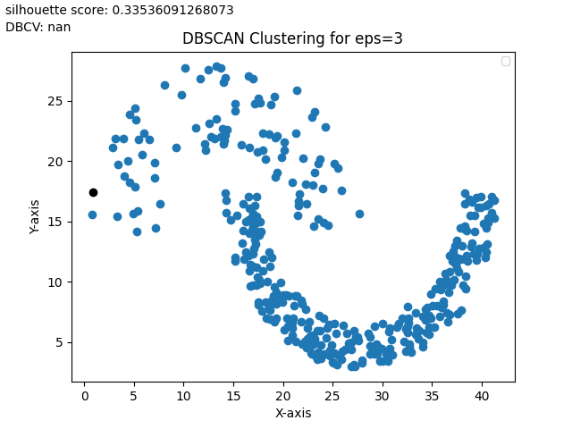
Dbscan results

Slide 8
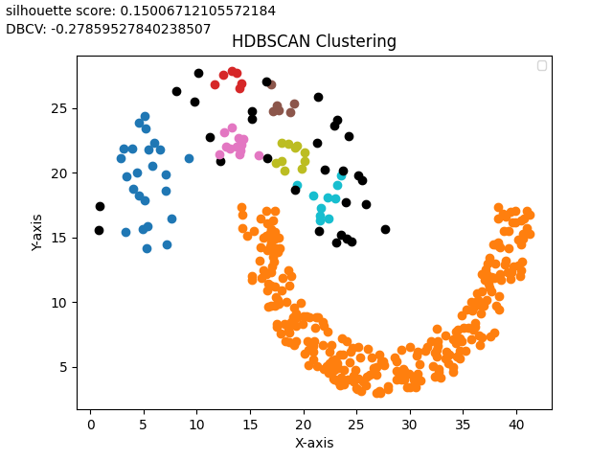
Hdbscan
Unlike dbscan, this method works well for datasets with varying densities, upper crescent is more sparse than lower one.
Doesn’t allow choosing clusters

Slide 9
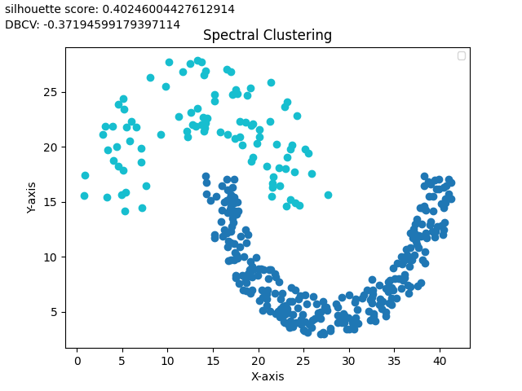
Spectral clustering
Ideal for non-flat geometry
Uses a graph based approach, instead of distance based
Creates a similarity matrix runs O(n^3)
Not ideal for large n
Allows choosing cluster count
(k=2) is a convex solution to the normalized cuts problem

Slide 10

How to find a solution in $R^{n}$
Silhouette score:
Ideal for convex shapes
Will favour centroid based algorithms:
Kmeans groups clusters based on minimum distance to the center
Naturally this maxes the silhouette score
Density based clustering validation (DBCV)
Ideal for non convex clustering.
Produces values between -1 and 1. Where 1 is best.
Density based approach where the most expensive internal path is compared to the least expensive path between clusters
Will naturally favour density based algorithms like Dbscan

Slide 11
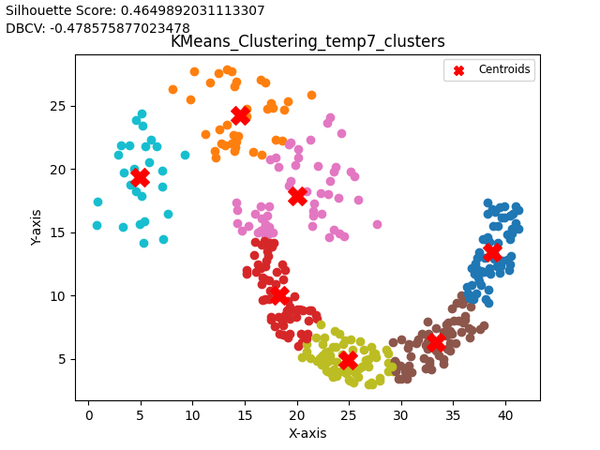

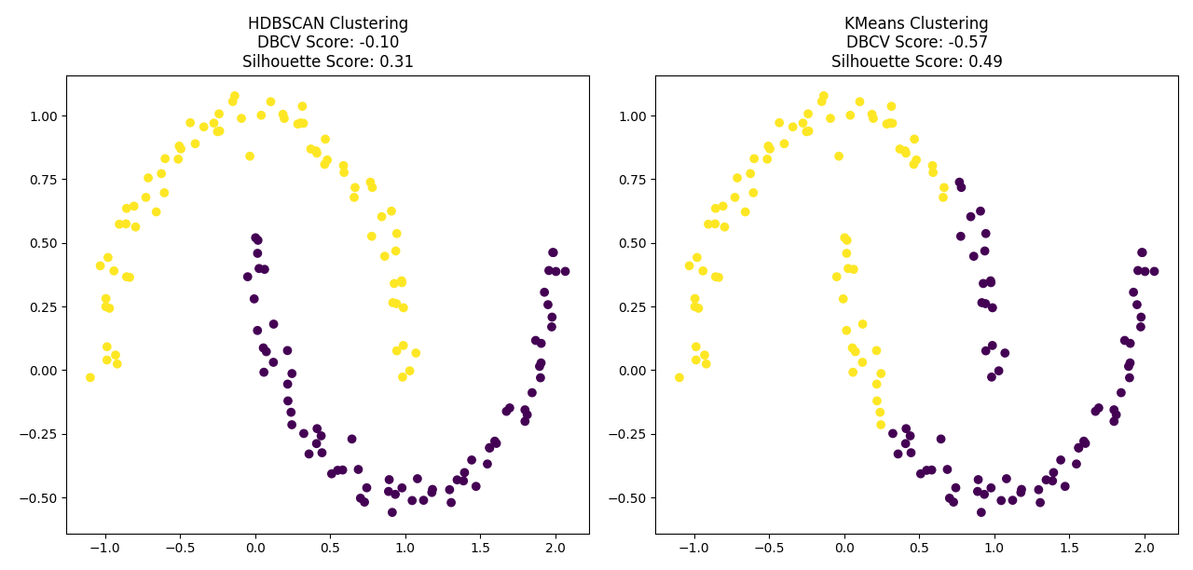
Constructed example to show the difference
Maximizing silhouette score yields subpar results
Maximizing DBCV, while still low suggests HDBSCAN.

